Slide 1
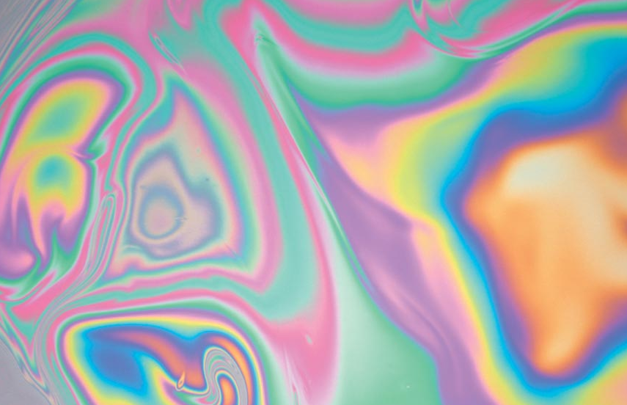
Interference of Light
PC2232 Lecture 03

Slide 2
Outline
Superposition
Constructive and Destructive Interference
Double Slit Interference
Intensity of Interference Pattern
Interference in Thin Film
Newton’s Ring
Michelson Interferometer
Photoelasticity

Slide 3

Introduction
We have added two waves of the same frequency (in phase or out of phase), with different polarizations but propagating in the same direction.
In this lesson, we will continue to look at what happens when we add two or more waves of the same frequency but they come from sources located at different points in space.
Interference commonly refers any situation where two (or few) waves overlap in space. When many waves or continuous sources are involved we usually use the term diffraction.

Slide 4
Principle of Superposition
When two or more waves overlap, the resultant displacement at any point and at any instant is found by adding the instantaneous displacements that would be produced at the point by the individual waves if each were present alone.
Principle of Superposition
Most waves obey this principle, including light in most instances.
Displacement above is used in general sense – may be the excess pressure in sound wave or the electric or magnetic field in EM waves.
Useful excel file: superposition.xls

Slide 5
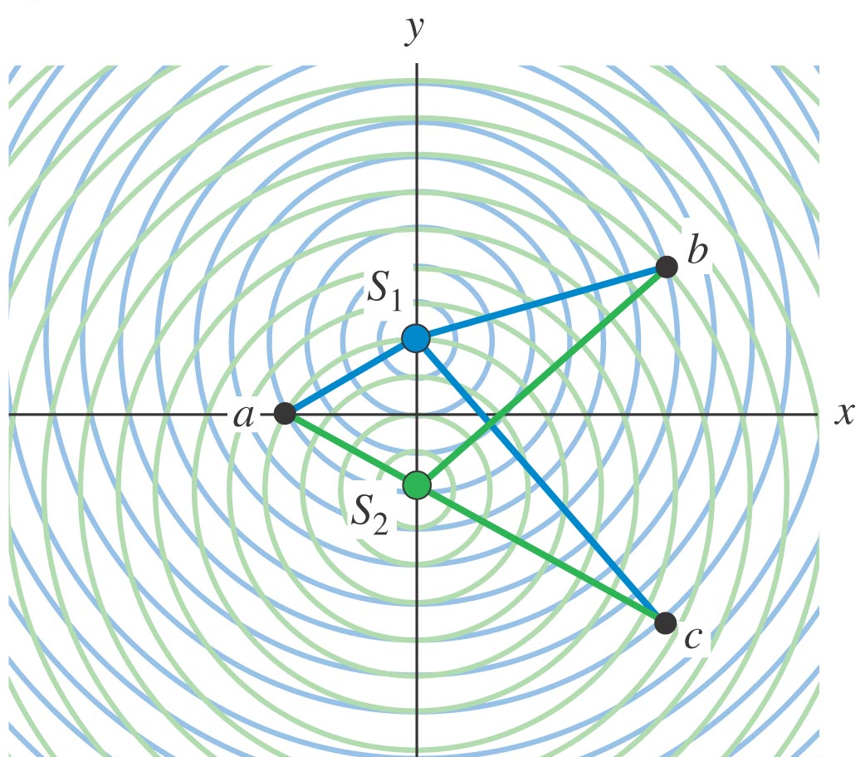
Superposition of waves
Consider two coherent sources of waves (water or light) as shown below. An interesting pattern is obtained where in some regions in space, the disturbance adds up (constructive) and in some regions, they cancel each other (destructive).
http://phet.colorado.edu/en/simulation/wave-interference

Slide 6
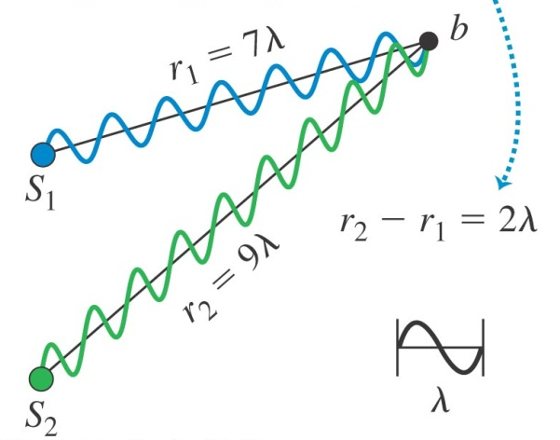


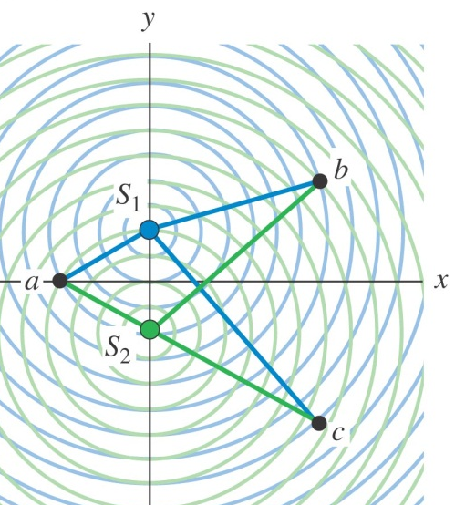
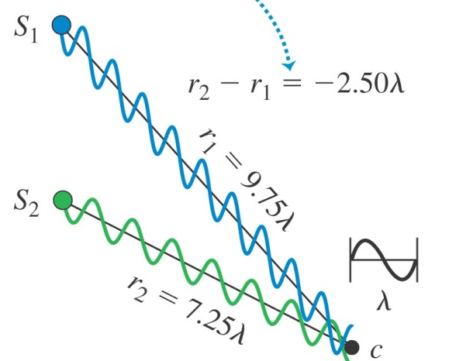
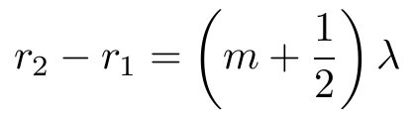
Constructive & Destructive Interference
Consider identical sources of monochromatic (same colour or wavelength) waves with zero phase difference between them.
For constructive interference, the two waves must arrive at the point, e.g., point b, in phase. This means that
For destructive interference, the two waves must arrive at the point, e.g., point c, 180° out of phase, gives

Slide 7
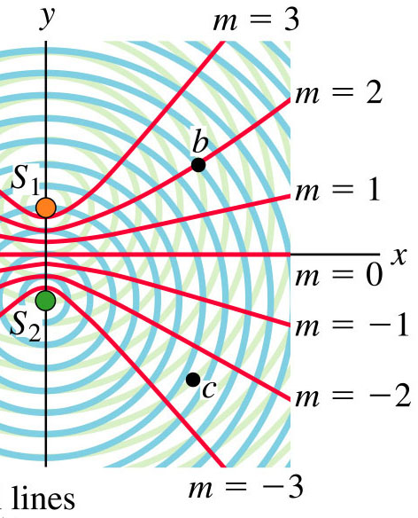
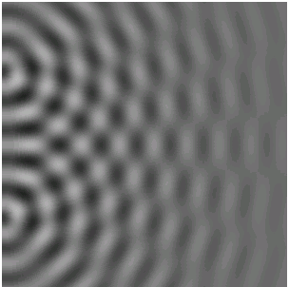
Nodal and Antinodal lines
The red lines denote the all points on which constructive interference occurs – known as antinodal lines – maximum amplitudes.
Nodal lines – all points where destructive interference occurs.

Slide 8
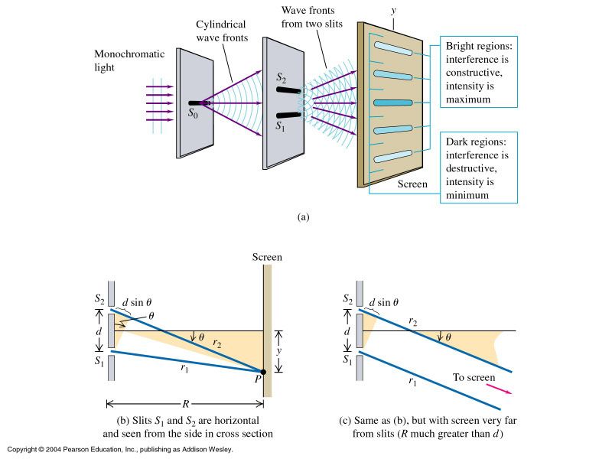
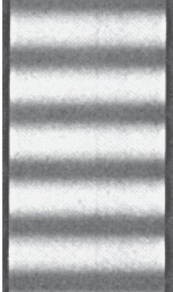
Double Slit Interference
Performed by Thomas Young in 1800.
Bright
Dark
http://www.colorado.edu/physics/2000/applets/twoslitsa.html

Slide 9



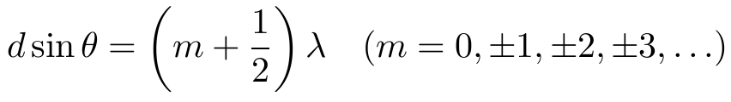
Double Slit Interference
Path difference:
Constructive interference
Destructive interference

Slide 10


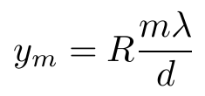
Double Slit Interference
Position of centre of m^{th} bright fringe from centre of pattern:

Slide 11

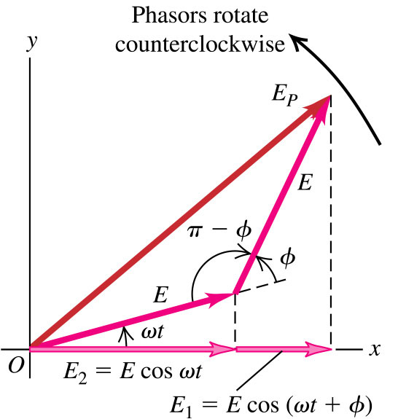

Intensity of Interference Pattern
As first approximation, let us assume that the waves reaching the point P on screen has the same amplitude E and same polarization.
If phase angle between waves at screen is φ, then the two fields may be written as
Phasor diagram: each sinusoidal function is represented by a rotating vector (phasor) whose projection on the horizontal axis at any instant represent the instantaneous value of the sinusoidal function.

Slide 12
Intensity of Interference Pattern
Note that both phasors have the same magnitude but E₁ is ahead of E₂ in phase by a constant angle φ.
Both phasors rotate counterclockwise with constant angular speed ω.
The sum of the projections on the horizontal axis at any time is the instantaneous value of the total E field at point P.
The amplitude (E_{P}) of the resultant wave at P is the magnitude of the phasor which is the “vector sum” of the original phasors.

Slide 13





Intensity of Interference Pattern
Using cosine rule
When the two waves are in phase, φ = 0 and E_{P} = 2E, and if out of phase, φ = π, E_{P} = 0.

Slide 14

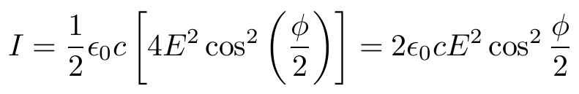



Intensity in Interference Pattern
Recall from lecture on EM waves, the intensity is given by
Maximum Intensity:
where
is the intensity of each wave.

Slide 15





Phase Difference & Path Difference
In general, the phase and path difference are related by:
k = wave number
If point P is far away from source:

Slide 16



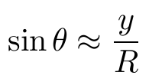
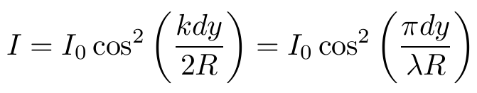


Phase Difference & Path Difference
The direction of maximum intensity occurs at
(as before)
For :
Note that if the medium is not vacuum but has refractive index n,
Wavelength in medium
Wave number in medium
in vacuum
in vacuum

Slide 17
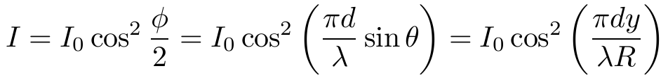
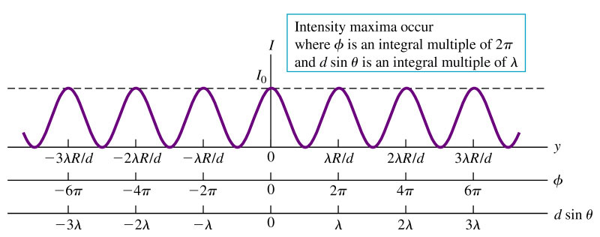
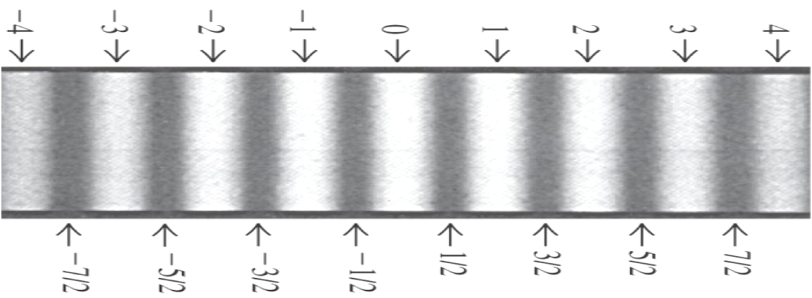
Intensity in Interference Pattern

Slide 18
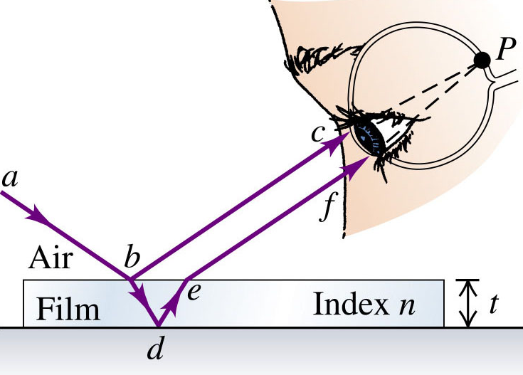
Interference in Thin Films
We often see bright bands of colour when light reflects from thin layer of oil floating on water or from a soap bubble.
This is due to interference of light from the two reflected waves as shown below.
The conditions for constructive and destructive interference depends also on the refractive index of film wrt to the other medium.

Slide 19
Phase Shift at surface
Air
Glass
Notice any difference?
Incident
Reflected
Glass
Air
Incident
Reflected

Slide 20
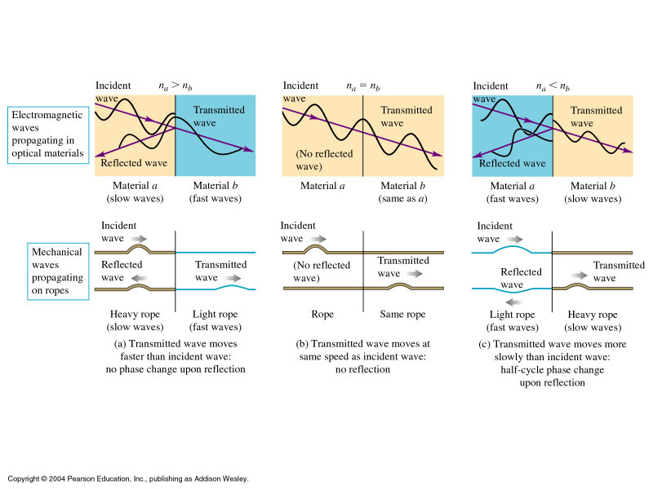

Phase Shift at surface
Recall in lecture on polarization, we can write for normal incidence:
This means that if:
  n_{a} > n_{b}: E_{r} has same sign as E_{i} (no phase shift)
  n_{a} = n_{b}: E_{r} = 0. No reflected wave. All energy transmitted.
  n_{a} < n_{b}: E_{r} has opposite sign to E_{i}. There is a π phase shift upon reflection.

Slide 21
Phase Shift at surface

Slide 22
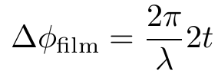
Interference in Thin Films
At normal incidence, if the film thickness is t, and wave has wavelength λ in film, then due to extra path in the film, the phase difference between the two waves:
The total phase difference will include another π radian if one of the waves has a phase shift of π at reflection.

Slide 23


Interference in Thin Film
If both or neither of the waves have a phase shift on reflection, then (no relative phase shift on reflection, e.g., n_{air} < n_{film} < n_{glass}):
  Constructive interference:
  Destructive interference:
If one of the two waves has a phase shift π on reflection, then (with relative phase shift on reflection, e.g., n_{air} < n_{glass} < n_{film}):
  Constructive interference:
  Destructive interference:

Slide 24

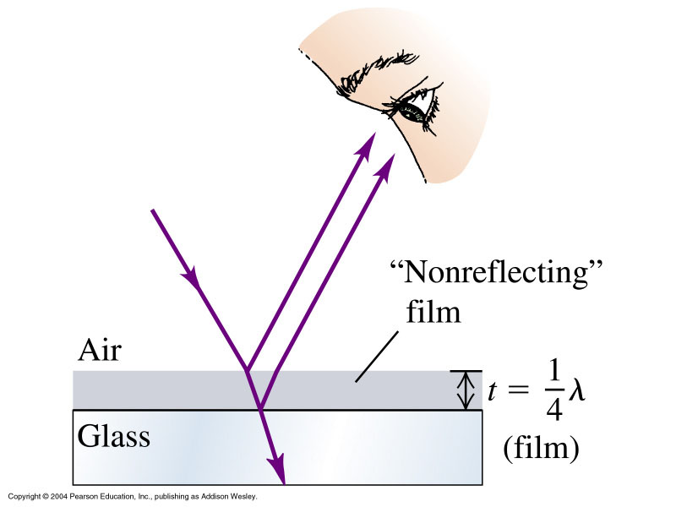
Anti-reflective Coating
Glass reflects about 4% (in intensity) of light at every surface at normal incidence.
They are often coated with an anti-reflective film that has refractive index of thickness t = λ/4 (λ is wavelength in film) so that the reflected beams from the air-film interface and film-glass interface are π out of phase and interfere destructively.
Note that material for the film is chosen such that both beams have π phase change on reflection, i.e.,
Note also that if n_{film} > n_{glass} and t = λ/4, then the two waves will have constructive interference, and intensity of reflected light will increase.

Slide 25
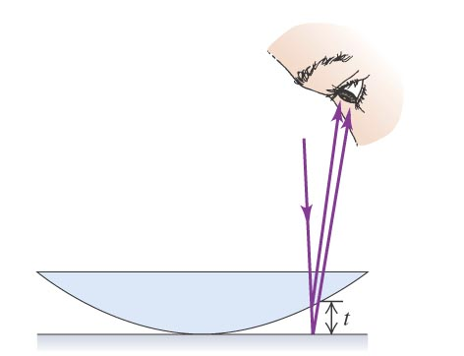
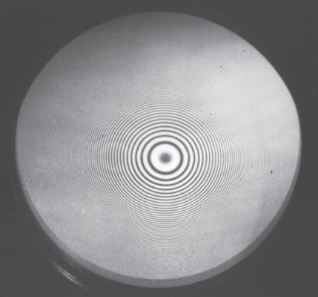
Newton’s Rings
If a convex surface is in contact with a plane glass plate, circular interference fringes, known as Newton’s rings, are formed.
Note that the central fringe or dot is dark. Can you explain why? (A thin film of air is formed between the two surfaces.)

Slide 26
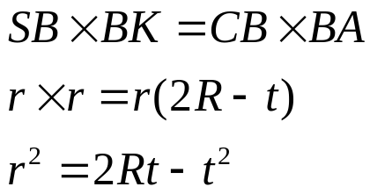


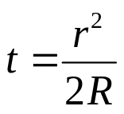
Newton’s Rings
A
R
r
r
S
B
K
t
C
Geometry
But t is very small so t² is even smaller and thus negligible

Slide 27
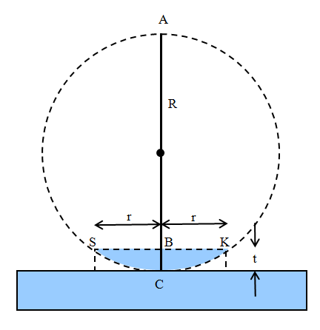
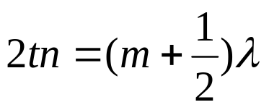

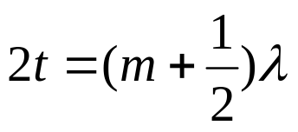
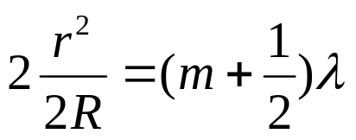
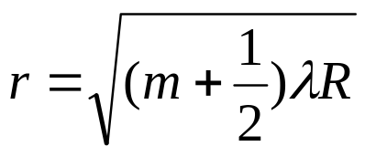
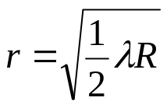
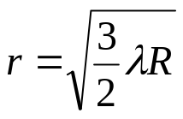

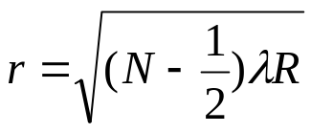
Newton’s Rings
Radius for Bright Ring
condition for constructive interference
To account for π phase shift upon reflection
Note n is the refractive index of the medium.
Consider thin air film, n = 1
and from previous slide
1st bright ring (m=0)
2nd bright ring (m=1)
3rd bright ring (m=2)
N^{th} bright ring (m=N-1)

Slide 28


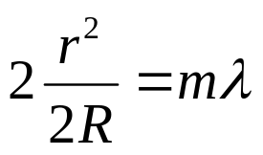



Newton’s Rings
Radius for Dark Ring
Note n is the refractive index of the medium.
Consider thin air film, n = 1
and from previous slide
m=0 ➔ r =0 i.e. point of contact is dark.
m=1,
m=2,

Slide 29
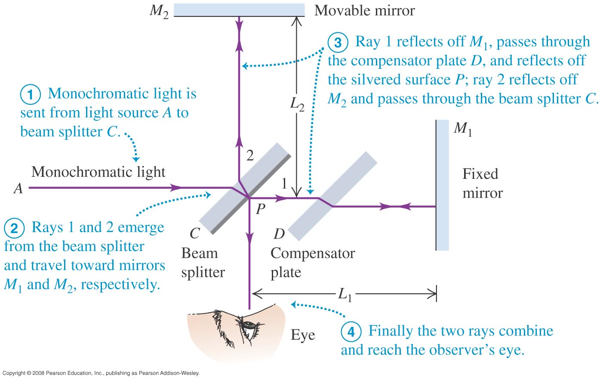


Michelson Interferometer
to ensure that rays 1 & 2 pass through the same thickness of glass
If the movable mirror moves a distance y, then the pattern will shift by m fringes given by:

Slide 30
Photoelasticity
Stresses in a structure can be analyzed by constructing a transparent model of the object. Usually we use a piece of plastic.
We can examine the stresses in the object by examining it between a polarizer and an analyzer in the crossed position.
Complicated stress distributions can be studied.
What is birefringent?
Birefringence is the optical property of a material having a refractive index that depends on the polarization and propagation direction of light.
Crystals with asymmetric crystal structures are often birefringent, as well as plastics under mechanical stress.
http://www.youtube.com/watch?v=WdrYRJfiUv0

